Slide 1
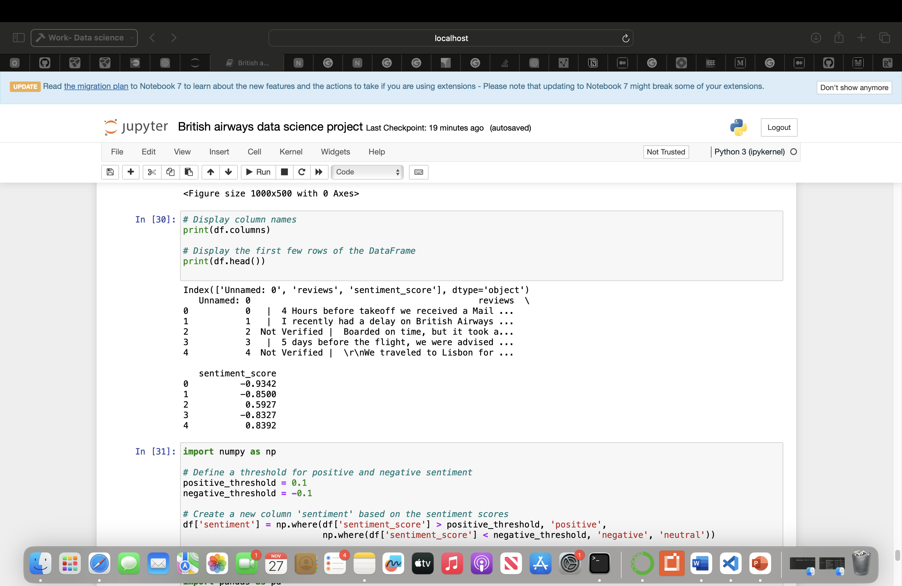
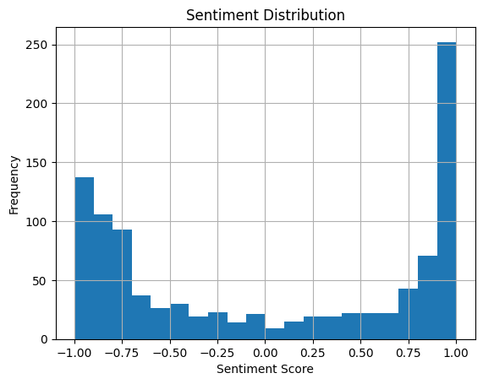
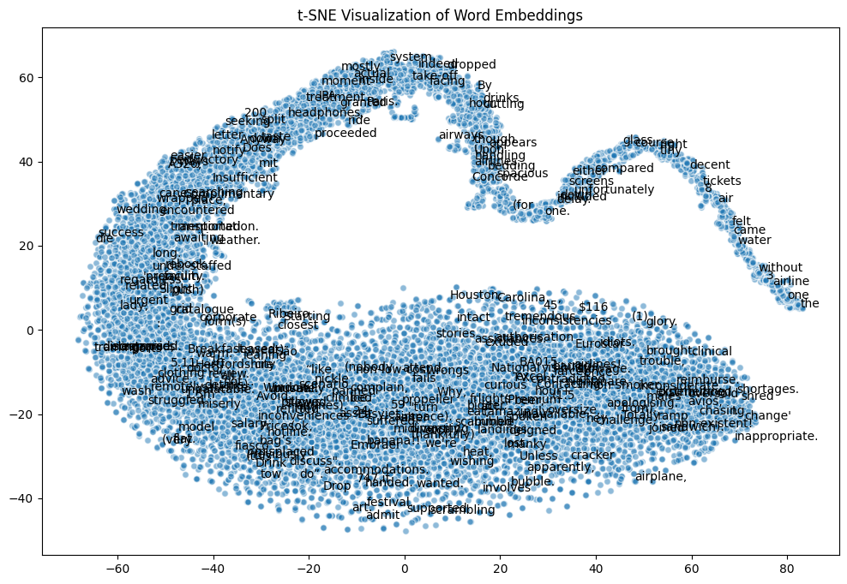
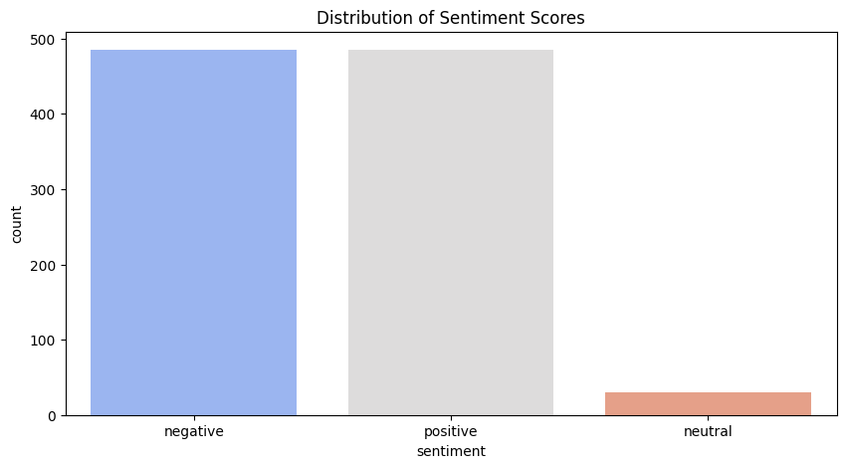
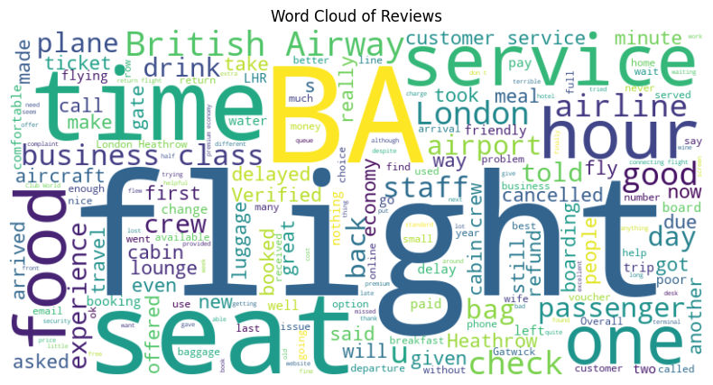
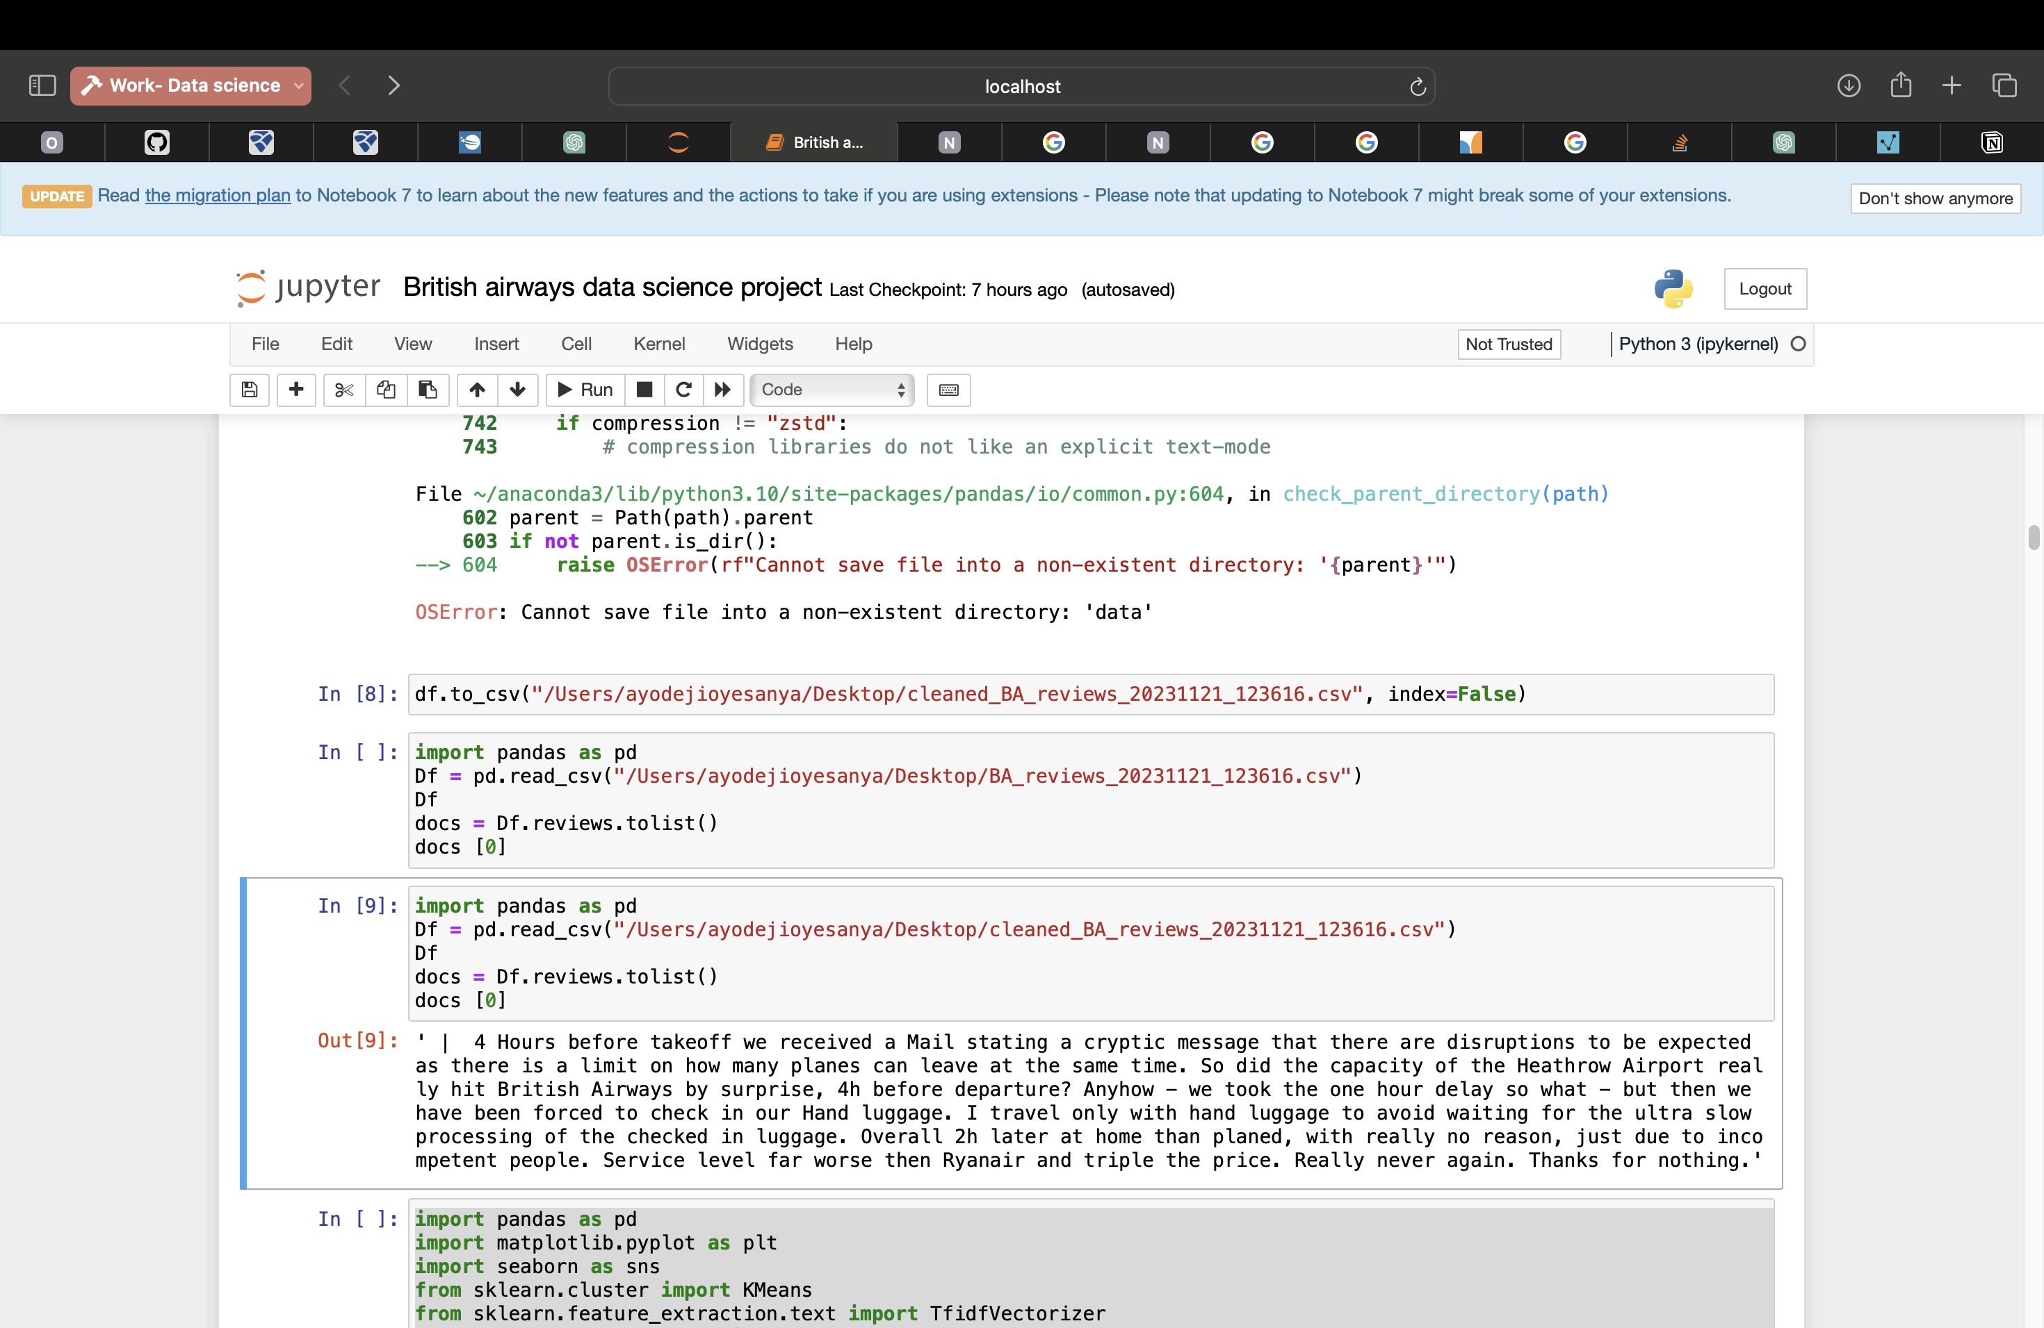
Business Insights from British Airways Reviews
Sentiment Analysis trends using VADER.
Insights: Highlight positive/negative sentiment shifts over reviews.
Topic Modelling:
- Natural language processing (NLP) algorithm used = Latent Dirichlet Allocation (LDA)
- This model allowed for review of main themes and topics discussed by customers by going through each word and reassigning . The NLP package Genism was used to implement this project
"Using Data Analysis and Embeddings”
By Ayodeji Oyesanya
Objective: Explore insights from British Airways reviews using data analysis.
Background: Understand the relevance of customer feedback for business decisions.
Model evaluation
The implementation of the LDA involved the following 6 steps: 1. loading data 2. Data cleaning 3. Exploratory analysis 4. Preparing data for LDA analysis 5. LDA model training 6. Analysing LDA model result
Review source:
The reviews were collected using webscapping methods and downloaded from Skytrax
Consisting of f 10 pages of 100 reviews.
Word Cloud
A visual representation of key terms and prevalent themes in the customer reviews. This allows for verification of pre-processing and if any more pre-processing is necessary before training the model
Data cleaning & analysis pipeline
Key Insights:
- similar trends regarding positive vs negative customer reviews as highlighted in the boxplot of the sentiment analysis
- in the t-SNE visualisation it is evident that there were clusters around the themes of waiting times, delays and passenger entertainment
Recommendations:
Actionable steps based on insights :
Passenger entertainment- option to pick meals and suggest allergies when booking
waiting times- Although unprecedented and difficult to establish prior but implementing virtual queuing and self-services desks to alleviate waiting times. Causation factors include bad weather, maintenance issues and security checks which are all avenues that can also be improved
Conclusion:
Mixed reviews but this provides an ideal opportunity for BA to improve their customer relations and can also introduce stakeholders and customer participation groups via social media campaigns
Data collection
Data cleaning and text mining-
Converting scrapped reviews to csv file and removing unnecessary characters such as ✅ Trip Verified
Data analysis
- Word cloud
Topic modelling and sentiment analysis
Analysis & visualization
Visual Highlights: t-SNE and UMAP:
- Uncover patterns in customer reviews.
- showing clusters and distribution trends.
The reviews are unstructured data and are converted to a CSV format
for relational database usage and to allow manipulation of data for subsequent analysis

